Slide 1
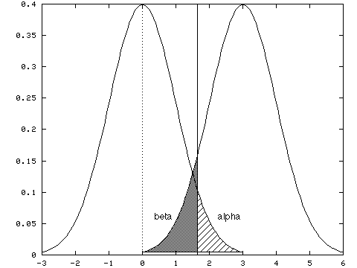
Tests of difference; Hypothesis testing
Geog4/6300

Slide 2

Ingredients of classical hypothesis testing
State the null and alternate hypothesis
Select the appropriate test
Select the level of significance
Delineate regions of rejection and non-rejection of the null hypothesis
Calculate the t-statistic
Make a decision
Notes:
Alternative hypothesis is usually what you’re trying to prove.

Slide 3
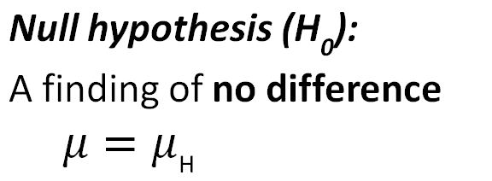
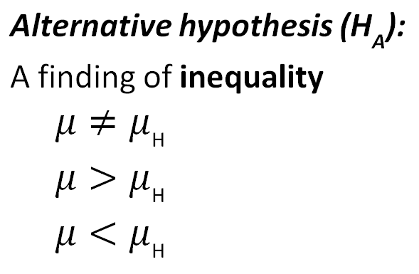
Steps in hypothesis testing
State the null and alternate hypothesis
Two-tailed test
Focuses on the assumption that no differences exist.
One-tailed test

Slide 4
Hypothesizing
Give the null and alterative hypothesis for the following research questions.
Is the average commute time higher on Mondays than it is the rest of the week?
Is the amount of property damage from severe weather different between southern states?
Is there an association between college teams’ football records and rates of student enrollment?
Is the rate of flu cases low in our area compared to our state?
Notes:
Alternative hypothesis is usually what you’re trying to prove.

Slide 5
Steps in hypothesis testing
State the null and alternate hypothesis
Select the appropriate test

Slide 6
Tests of difference
What is the specific purpose of this test? When would you use it rather than another one?
One sample t-test
Two sample t-test
Two sample paired t-test
Non-parametric (Wilcoxon) t-test
Difference test between two proportions

Slide 7
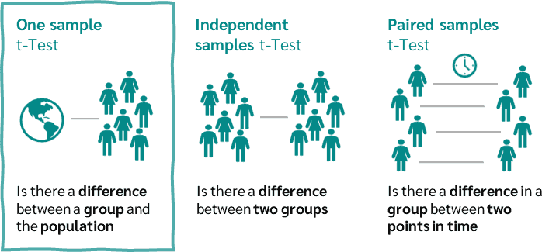
Types of difference

Slide 8
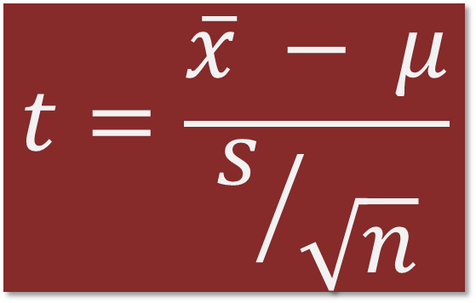
How do t-tests work?
One sample test:
How many standard errors is the sample mean from the population mean?
$$t=\frac{\overline{x} − μ}{s/{\sqrt{n}}}$$
Review: What percentage of sample means are within one standard error of the population mean for a large sample? What percentage are within two?

Slide 9
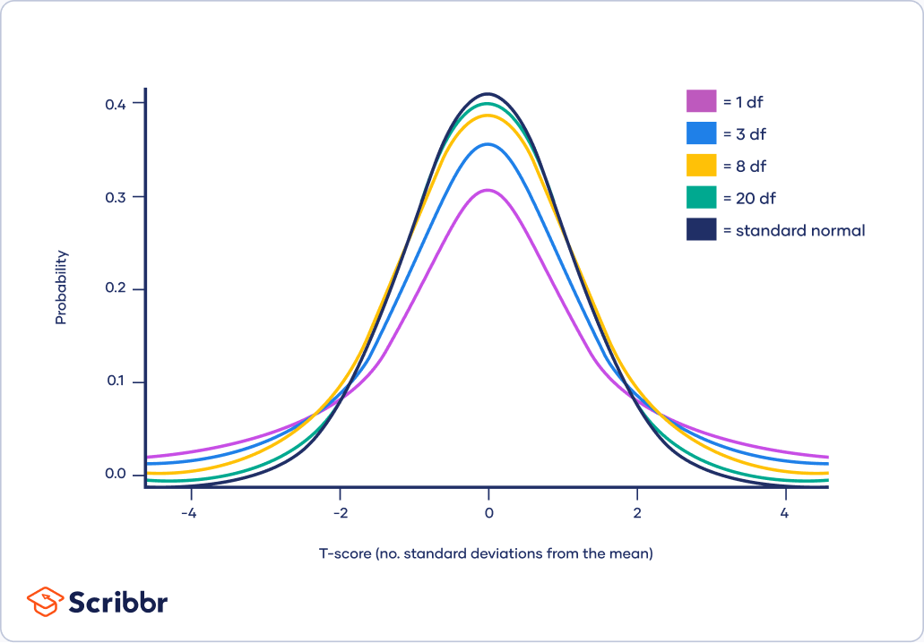
T-distributions are for small samples
Degrees of freedom (df):
Sample size (n) – 1
Small sample sizes = “fatter” tails
Main differences are for n<30
https://private.smaat.de/t-distribution-detailed-table-z-table/

Slide 10

The key role of beer!

Slide 11
Tests of difference
What is the specific purpose of this test?
Can you come up with a research question that would require it?
One sample t-test
Two sample t-test
Two sample paired t-test
Non-parametric (Wilcoxon) t-test
Difference test between two proportions

Slide 12
Steps in hypothesis testing
State the null and alternate hypothesis
Select the appropriate test
Select the level of significance

Slide 13
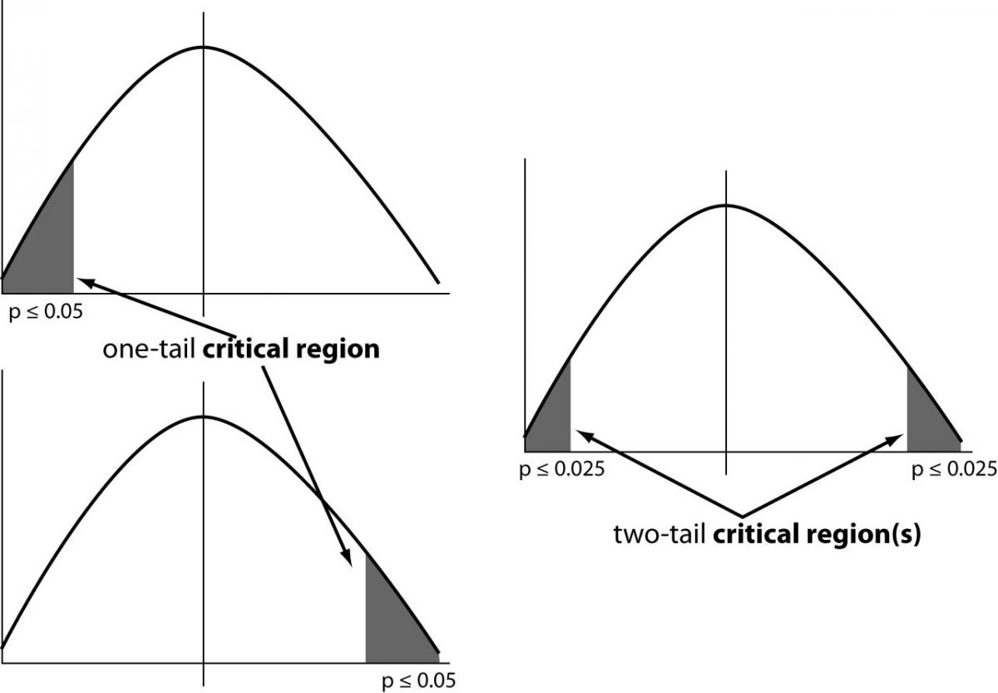
Select level of significance
P < 0.05:
The probability that this sample comes from a population in which the two means are equal is less than 5%

Slide 14
Steps in hypothesis testing
State the null and alternate hypothesis
Select the appropriate test
Select the level of significance
Delineate regions of rejection and non-rejection of the null hypothesis

Slide 15
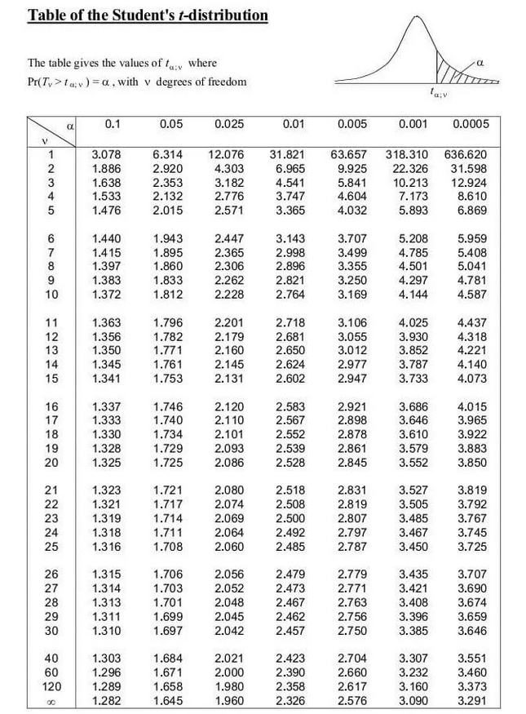
Delineate regions of rejection / non-rejection
Degrees of freedom:
One sample test: n-1 (24 in our case)
Critical value:
Based on confidence level (alpha) and df

Slide 16
Delineate regions of rejection / non-rejection
Degrees of freedom:
One sample test: n-1 (24 in our case)
Critical value:
Based on confidence level (alpha) and df

Slide 17
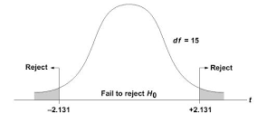
Reject or fail to reject?
Based on test results, we reject or fail to reject the null hypothesis.
We don’t prove or disprove it, but show it is likely or unlikely to be true.
Notes:
Alternative hypothesis is usually what you’re trying to prove.

Slide 18
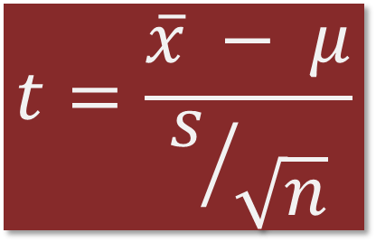
Steps in hypothesis testing
State the null and alternate hypothesis
Select the appropriate test
Select the level of significance
Delineate regions of rejection and non-rejection of the null hypothesis
Calculate the t-statistic
$$t=\frac{\overline{x} − μ}{s/{\sqrt{n}}}$$
How many standard errors is the sample mean from the population mean?

Slide 19

One sample t-test: Oak trees
Example: Are oak trees in our area (n=28) the same age as those throughout the state?
Sample area:
Mean age: 65 years Standard deviation: 7.3 years
State:
Mean age: 57 years
$$t=\frac{\overline{x} − μ}{s/{\sqrt{n}}}$$

Slide 20

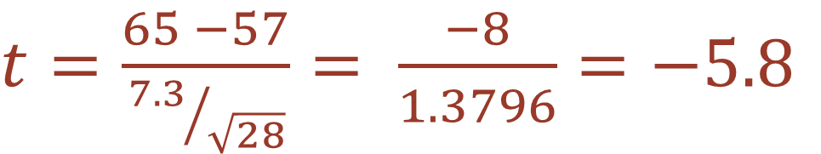
One sample t-test: Oak trees
Example: Are oak trees in our area (n=28) the same age as those throughout the state?
Sample area:
Mean age: 65 years Standard deviation: 7.3 years
State:
Mean age: 57 years
$$t=\frac{\overline{x} − μ}{s/{\sqrt{n}}}$$
$t=\frac{65 −57}{{7.3}/{\sqrt{28}}}= \frac{−8}{1.3796}=−5.8$

Slide 21
Steps in hypothesis testing
State the null and alternate hypothesis
Select the appropriate test
Select the level of significance
Delineate regions of rejection and non-rejection of the null hypothesis
Calculate the t-statistic
Make a decision

Slide 22

$$t=\frac{\overline{x} − μ}{s/{\sqrt{n}}}$$
Let’s try it out
The American Community Survey indicates that statewide, the average commute time is 22 minutes
We surveyed 36 community members:
Mean commute: 17.2 minutes
Standard deviation: 3.2 minutes
Is our group different from the state average?

Slide 23
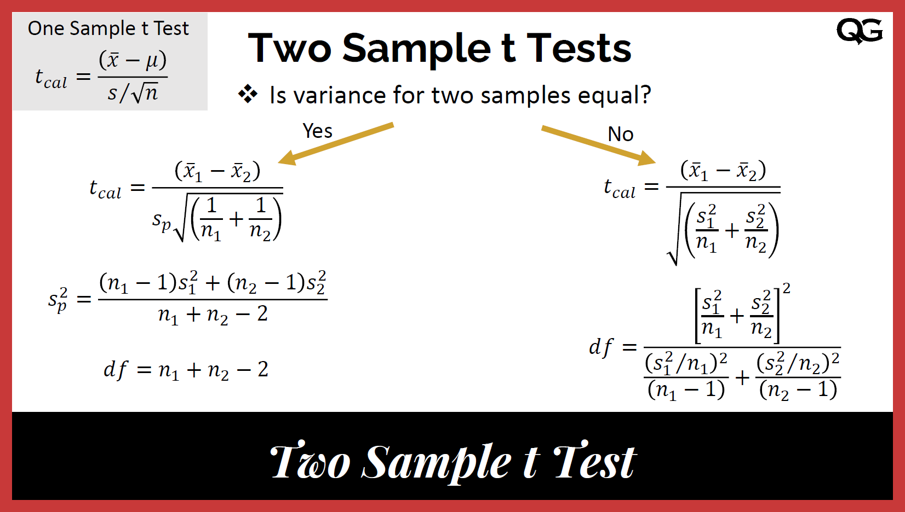
Two sample t-tests
Standard error depends on variance in the sample.
With two samples: are the variances equal or unequal?
https://www.qualitygurus.com/two-sample-t-test/

Slide 24
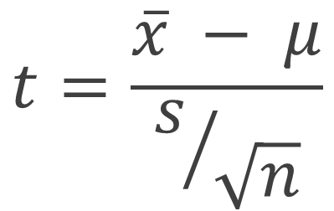
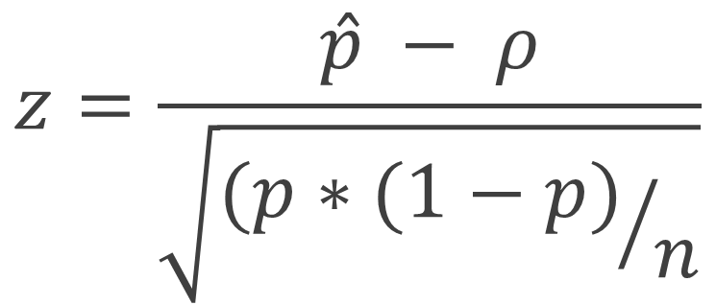
How are proportions different?
The standard error is different for proportions/rates.
We also use a z statistic rather than a t-statistic
One sample T-test for counts
Z-test for proportions
$$z=\frac{\hat{p} − ρ}{\sqrt{{(p∗(1−p)}/n}}$$
$$t=\frac{\overline{x} − μ}{s/{\sqrt{n}}}$$

Slide 25
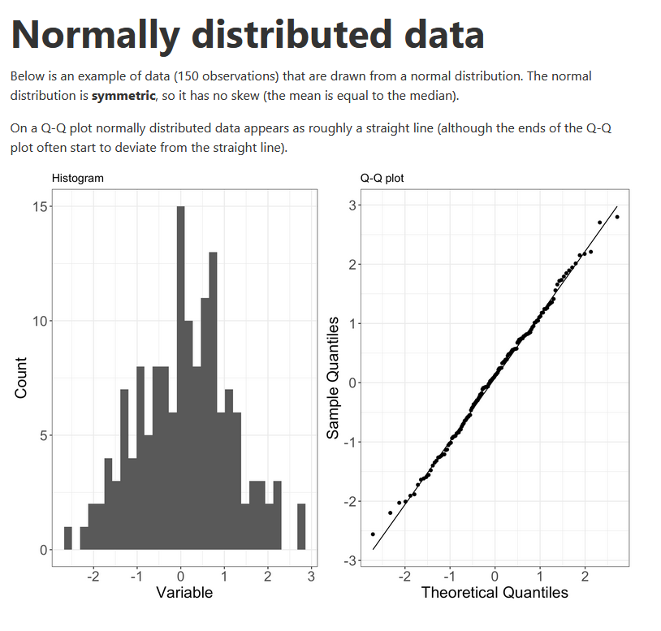
How do we assess normality?
Histograms
QQ plots
Normality tests
https://www.ucd.ie/ecomodel/Resources/QQplots_WebVersion.html
Notes:
Alternative hypothesis is usually what you’re trying to prove.

Slide 26
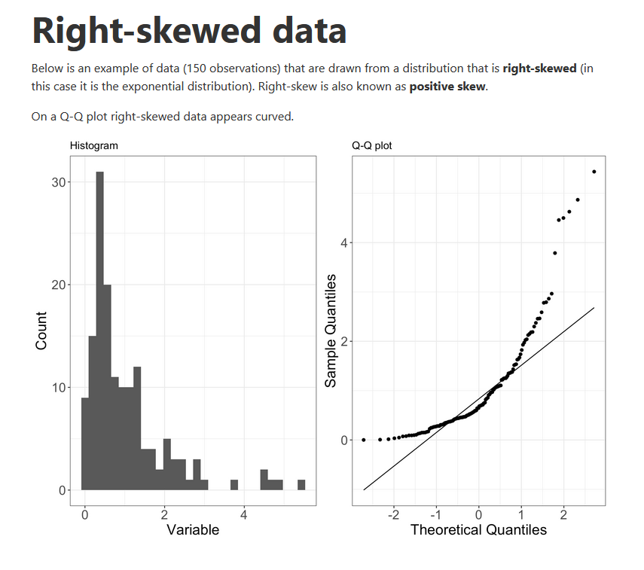
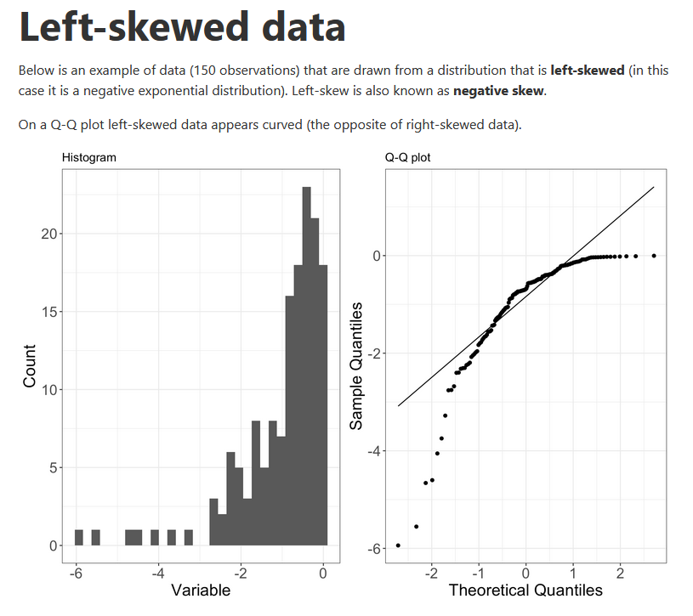
More on QQ plot shapes
https://www.ucd.ie/ecomodel/Resources/QQplots_WebVersion.html
Notes:
Alternative hypothesis is usually what you’re trying to prove.

Slide 27
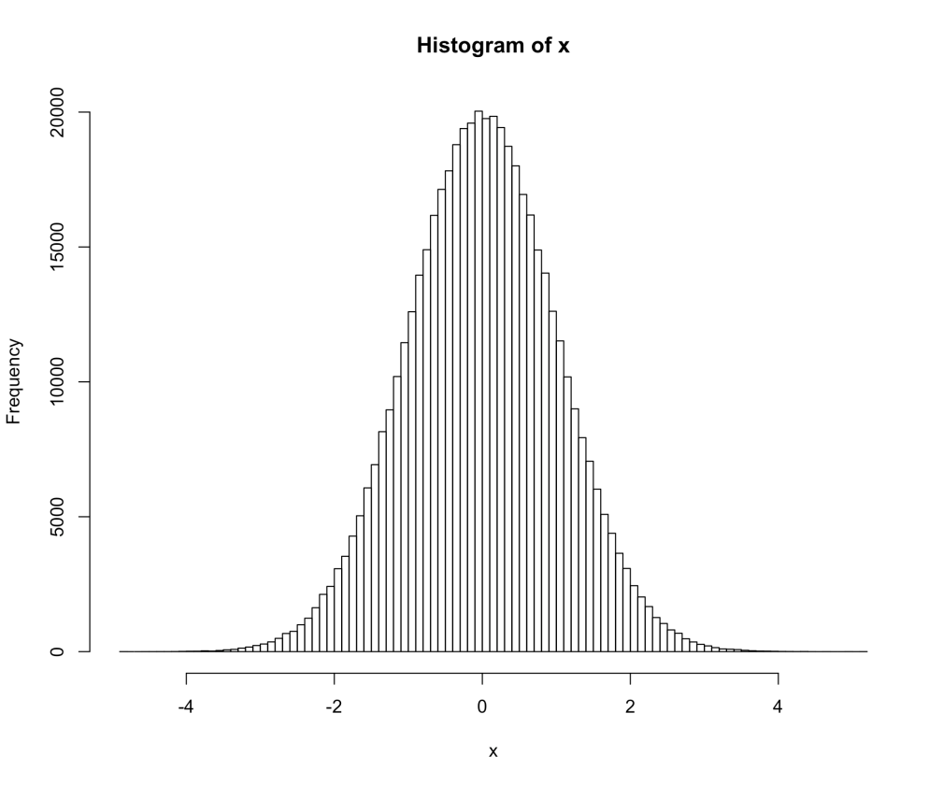
Testing normality
The Shapiro-Wilk normality test compares the actual distribution to a normal distribution, measuring the gap between them at multiple points.
There are other normality test, but this one has more power when compared to other tests, especially with smaller (<50) samples.

